Slide 1
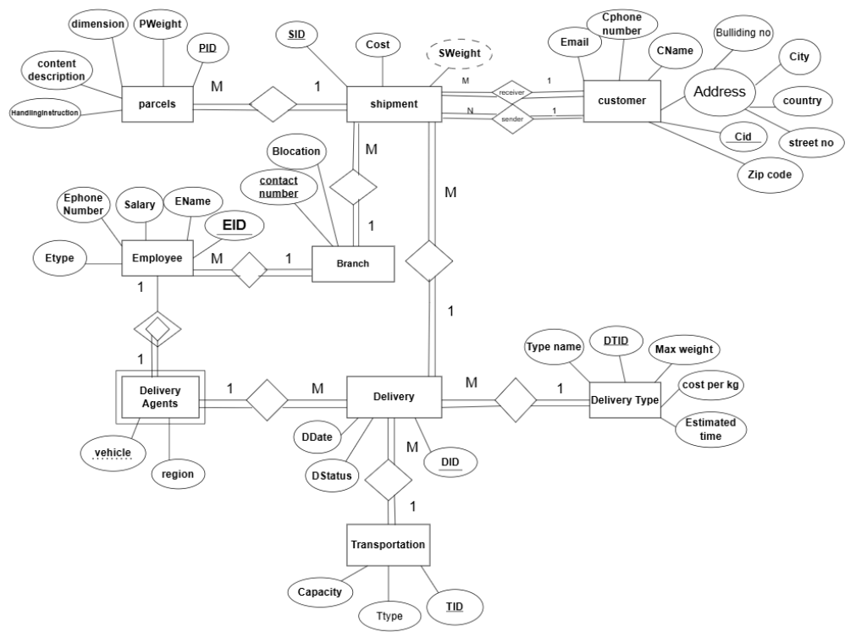
ERD:

Slide 2
Data Base:
Based on the information we collected from the customer service employee in the Nablus branch and in addition to the information collected from the company's website, we can describe the database system (Aramex) as follows:
The company relies mainly on international and domestic delivery.
The company has a network of branches that extends in Palestine and a number of countries around the world, allowing it to fully meet the needs of its customers, and one branch is characterized by(contact number,Blocation) ,In addition, there is no branch without employees and that one branch exports a number of shipments and the same branch produces a number of connections to deliver those shipments

Slide 3
Office clerks and Delivery agents share a number of characteristics (EID,Ename,salary,Etype,phone number)and the Delivery agents has their own information that helps connect deliveries to the system(vehicle id,region).
The delivery agent is associated with deliveries so that each delivery contains (DID,Ddate,DStatus) and the delivery is linked to several shipments.
The delivery process is carried out by one means of transport and the delivery company is concerned with the type of transport process used( Ttype ,TID ,capacity).

Slide 4
The delivery process varies in information based on the type of operation, whether it is domestic or international( DTID,max weight, cost per kg, Type name).
One shipment contains several parcels and there is no shipment without parcels and all parcels, even if one parcel is taken out by shipment, and certain information about the parcel must be known, such as (pID,pweight,content descrprion,dimention), as for the shipment, it must contain information such as (SID,Cost) and also contain the weight of the total shipment, which is the sum of the weights of the parcels.
Each shipment is linked to one customer so that this customer can be either a sender or a receiver, and each sender has a receiver, and the customer's information is stored so that one shipment can be a sender and the other receiver (recersuve).

Slide 5
Each customer contains information so that it is shared between the sender and the receiver(id ,name ,address,phone number,email), and certainly the sender can have more than one shipment and the receiver can receive more than one shipment from one or more senders.
Any customer recorded in the customer register is associated with a particular shipment.
The database is designed to provide an integrated system that manages all aspects of shipping and delivery operations, from tracking customers and shipments to managing branches and employees. The model ensures flexibility in handling data and accuracy in tracking parcels and deliveries, with the addition of custom details for delivery personnel and means of transportation. The goal is to achieve high efficiency in managing operations and improving the customer experience.

